Slide 1

Vision
Vision of the Institute
To impart quality technical education with a focus on Research and Innovation emphasizing on Development of Sustainable and Inclusive Technology for the benefit of society.
Vision of the Department
To provide a vibrant learning environment in computer science and engineering with focus on industry needs and research, for the students to be successful global professionals contributing to the society.
DAYANANDA SAGAR COLLEGE OF ENGINEERING
Department of Computer Science & Engineering

Slide 2
SSH Protocol Configuration
What is SSH(Secure Shell) Protocol?
SSH or Secure shell is a network communication protocol, which is protocol that enables two computers to communicate and share data. An inherent feature of ssh is that communication is encrypted meaning that it’s suitable for use on insecure networks.It is an application layer protocol
DAYANANDA SAGAR COLLEGE OF ENGINEERING
Department of Computer Science & Engineering

Slide 3
SSH Protocol Configuration
What is telnet and advantages of ssh over telnet?
Telnet(Telecommunications and Networks) is a network communication protocol,launched alongside Net in 1969.Telnet is an application protocol that helps users communicate with a remote system.It uses a text-based interface to create a virtual terminal ,allowing adminstrators to access applications on other devices
DAYANANDA SAGAR COLLEGE OF ENGINEERING
Department of Computer Science & Engineering

Slide 4
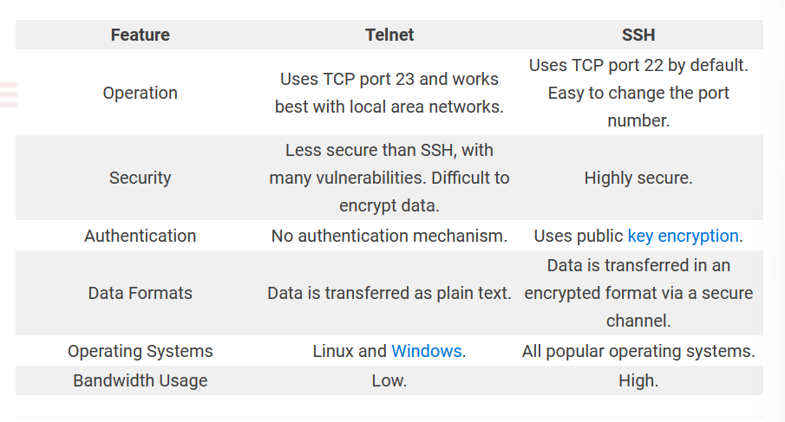
SSH Protocol Configuration
DAYANANDA SAGAR COLLEGE OF ENGINEERING
Department of Computer Science & Engineering

Slide 5
SSH Protocol Configuration
What is SSH(Secure Shell) Protocol?
SSH or Secure shell starts by establishing a secure connection to the server through port 22 (although you can change the port number).With key-based authentication , after the client verifies the server, a session key is generated and sent to both client and the server. This key encrypts the traffic for the ongoing session. Finally , the server verifies the client using an SSH key pair generated . Once the client is authenticated , an encrypted connection is established, and the two systems securely exchange data.
Security –key pairs for authentication
Authentication- The most common and secure SSH is public key authentication.When an SSH key pair is generated,the client holds the private key,while the public key is sent to a server.If a client tries to access a server using SSH, the server authenticates the client the public key to the private key if the key matches the two systems can establish a secure connection.
DAYANANDA SAGAR COLLEGE OF ENGINEERING
Department of Computer Science & Engineering

Slide 6
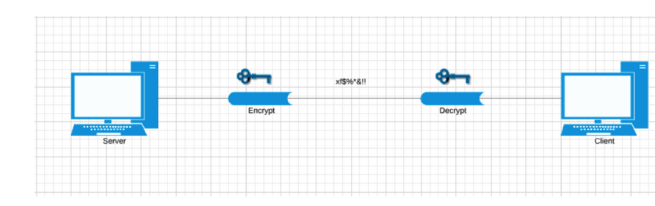
SSH Protocol Configuration
DAYANANDA SAGAR COLLEGE OF ENGINEERING
Department of Computer Science & Engineering

Slide 7
SSH Protocol Configuration
Types of Encrpytions used in SSH?
Symmetric encryption –shared key encryption,symmetric encryption is usually a single key or a pair of keys used for both encryption and decryption.Used to encrypt the entire session of communication.The key is calculated on agreed methods
Asymmetric encryption – Uses a pair of keys for encryption and decryption.These are called as public and private keys,The public key is distributedThe private key is closely related to the public key in terms of functionality but cannot be calculated just by knowing the public key.
HashingHashing is the process of mapping any arbitrary size data into a fixed-length value using a hash function. This fixed-length value is known as a hash value, hash code, digest, checksum, or simply hash.
DAYANANDA SAGAR COLLEGE OF ENGINEERING
Department of Computer Science & Engineering

Slide 8
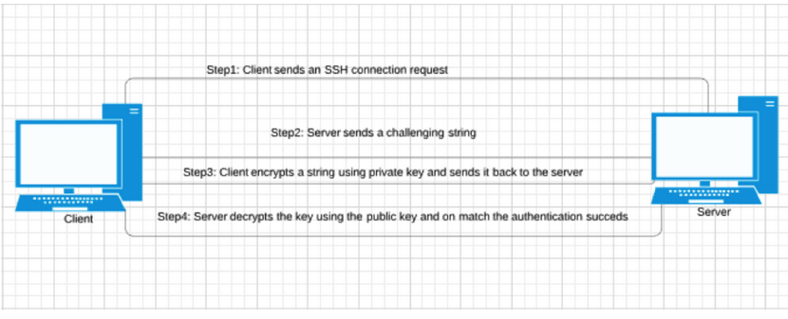
SSH Protocol Configuration
Types of Encrpytions used in SSH?
DAYANANDA SAGAR COLLEGE OF ENGINEERING
Department of Computer Science & Engineering

Slide 9
SSH Protocol Configuration
What will be our SSH Config?
The 6 steps of configuration in cisco packet tracer:
IP Configurations
Password Encryption
Router Name Change
Domain Data and Data Encryption
Router User Config
SSH Config
SSH Verification
DAYANANDA SAGAR COLLEGE OF ENGINEERING
Department of Computer Science & Engineering

Slide 10
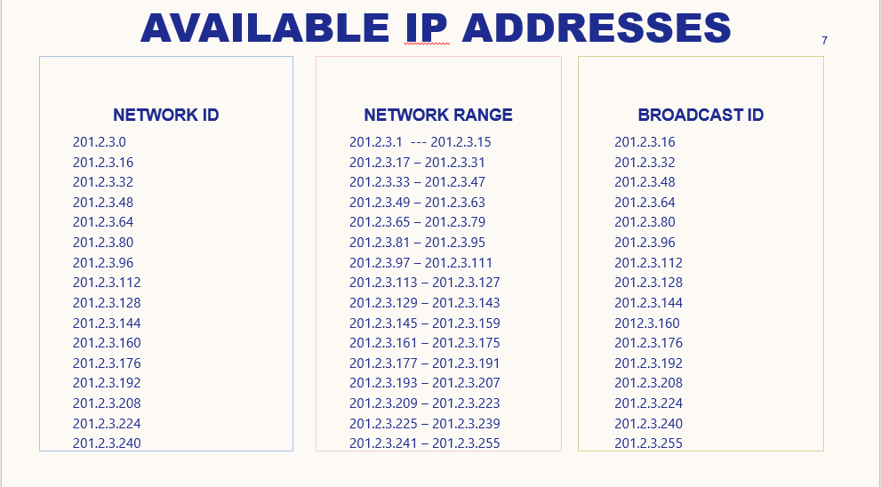
SSH Protocol Configuration
Calculation of the Subnets (201.2.3.0)
Requirements are 15 networks
DAYANANDA SAGAR COLLEGE OF ENGINEERING
Department of Computer Science & Engineering

Slide 11
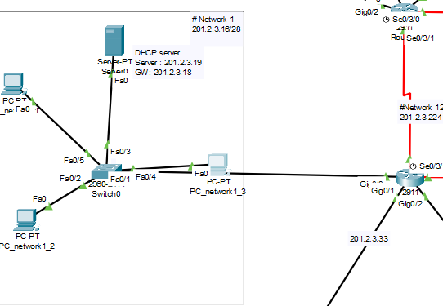
SSH Protocol Configuration
IP configurations
DAYANANDA SAGAR COLLEGE OF ENGINEERING
Department of Computer Science & Engineering

Slide 12
SSH Protocol Configuration
IP configurations(Network 1 an Example)
Router Gig0/0 Interface
IP : 201.2.3.18/28
Subnet : 255.255.255.240
PC
IP : 201.2.3.20/28
Subnet : 255.255.255.240
Gateway : 201.2.3.18
DHCP
IP : 201.2.3.19/28
Subnet : 255.255.255.240
Gateway : 201.2.3.18
DAYANANDA SAGAR COLLEGE OF ENGINEERING
Department of Computer Science & Engineering

Slide 13
SSH Protocol Configuration
Router Configurations
Router Gig0/0 Interface Configuration:
Router # configure terminal
Router (config) # interface GigabitEthernet0/0
Router (config-if) # ip address 201.2.3.18 255.255.255.240
Router (config-if) # no shutdown
Router (config) # exit
Router (config) # hostname R1
Router (config) # ip ssh version 2
Router (config) # crypto key generate rsa general-keys modulus 1024
Router (config) # line vty 0 15
Router (config-line) # transport input ssh
Router (config-line) # exit
Router (config) # username admin privilege 15 secret cisco
DAYANANDA SAGAR COLLEGE OF ENGINEERING
Department of Computer Science & Engineering

Slide 14
SSH Protocol Configuration
Router : Routers are networking devices operating at layer 3 or a network layer of the OSI model.
Enable : To make operational or activate through a software setting , a hardware button or a jumper.
Config : A Configuration is the arrangement or the process of making the arrangement of the parts that make up a whole.
Interface gigabitEthernet0/0 : gigabitEthernet0/0 is up , line protocol is up(connected).
No Shutdown : The command “no shutdown” enable the interface to move from administration down status to UP.
Show IP SSH : Displays SSH connections details.
Hostname R1 : A Hostname is a unique name given to a device router R1on a network and is used to identify one device from another on a specific network over the internet.
IP Domain name : An IP domain name is used on a router so the router can do look ups.
DAYANANDA SAGAR COLLEGE OF ENGINEERING
Department of Computer Science & Engineering

Slide 15
SSH Protocol Configuration
Crypto Key generate RSA : SSH may generate an additional RSA key pair if we generate a kep pair on a router having no RSA keys.
Modulus 1024 : Command pompt crypto key generate modulus 1024.
IP SSH Version 2 : SSH Version 2 Configuration ,the SSH protocol is a method
for secure remote login from one device to other.
Line vty 0 15: It is kind of range command,we are giving range of vty(virtual terminal line) from 0 to 15.
Transport input SSH : We use the cisco ‘transport input’ command to set which protocols are allowed to access the virtual terminal lines.
Login local : Login local command is used to ensure the secure remote login by telnet
and it is also used to store the information about that remote users in the database.
Username admin privilege 15 secret cisco : Cisco devices use privilege levels to provide password security for different levels of switch operation.
Exit : To exit any configuration mode or close an active terminal session and terminate
the EXEC,use the exit command at the system prompt.
DAYANANDA SAGAR COLLEGE OF ENGINEERING
Department of Computer Science & Engineering

Slide 16
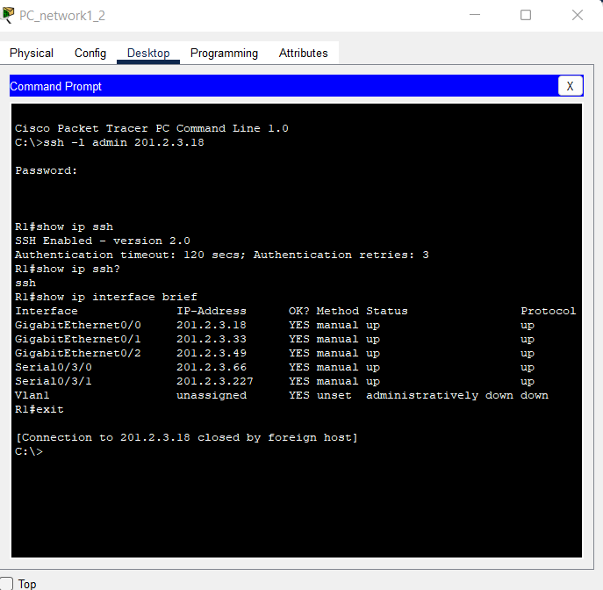
SSH Protocol Configuration
Remote Connection of the router on an end device
DAYANANDA SAGAR COLLEGE OF ENGINEERING
Department of Computer Science & Engineering

Slide 17
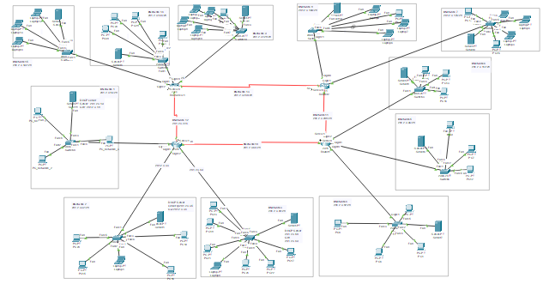
SSH Protocol Configuration
Topology of 15 networks
DAYANANDA SAGAR COLLEGE OF ENGINEERING
Department of Computer Science & Engineering

Slide 18
SSH Protocol Configuration
Presented By:
Joseph Raj Vishal -1DS20CS093
Jyothi Ramesh -1DS20CS094
K.L.Kalpana-1DS20CS095
DAYANANDA SAGAR COLLEGE OF ENGINEERING
Department of Computer Science & Engineering

